Slide 1
VAE Autoencoder Workshop
By Callum Melrose, Shiva Veera, Ben Annicelli

Slide 2
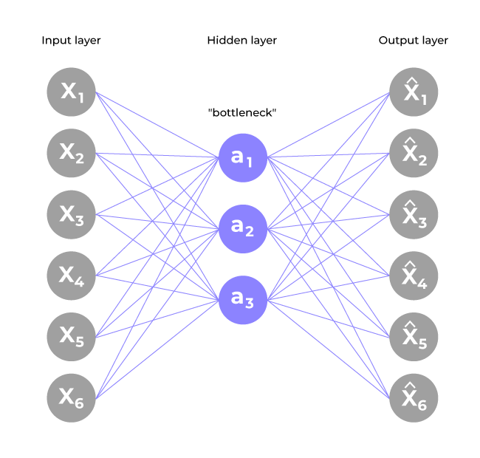
What are AutoEncoders
An Autoencoder differs from a regular encoder because it compresses the input data into a lower resolution which recreates a representation from the input data
3 Parts to an AutoEncoder:
Encoder - compresses data into the latent space i.e. a hidden layer
Data (aka Bottleneck) - smallest, most compressed data
Decoder - reconstructs the compressed data
Use cases:
Anomaly detection
Autoencoders are good at identifying noisy anomalies in images and data
Image Processing
Good for removing noise from images while retaining important features
Can be trained to improve image quality and resolution
Generative models
Can be used to generate synthetic images or data if not enough data is present

Slide 3
What does this mean?
Input
Encoder
Bottleneck
Output
Decoder
Original
image
Most compressed version of input
Slightly altered
image
Slowly compresses original input
Removes noise from input
Slowly decompresses bottleneck
Recreates original input

Slide 4
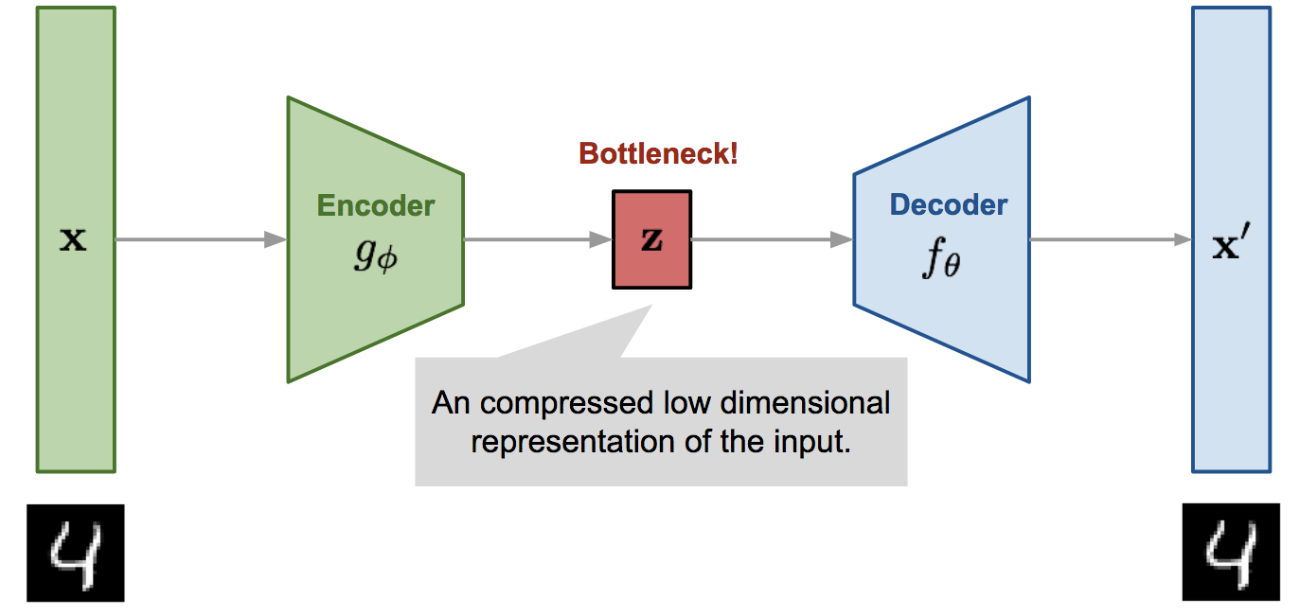
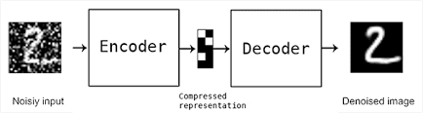
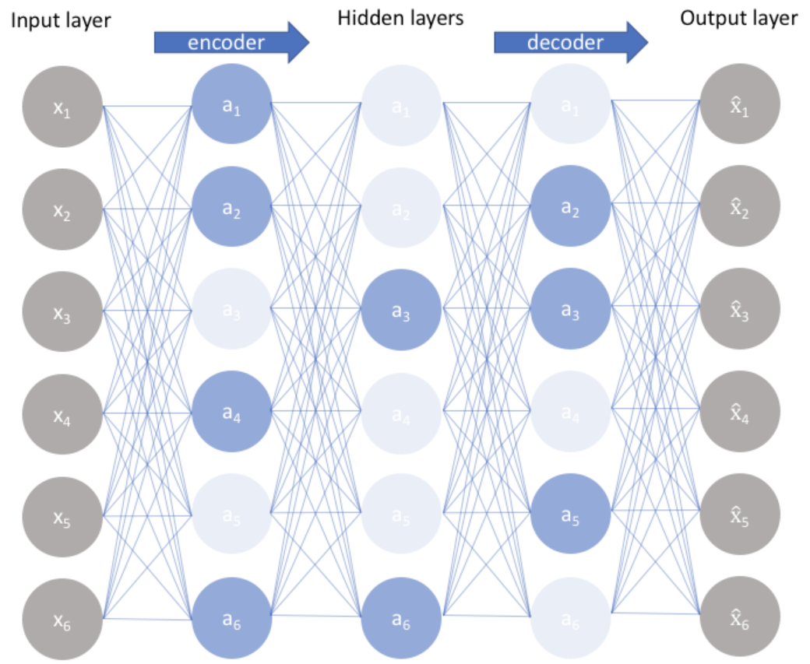
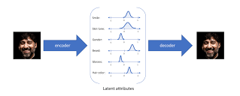
Types of Autoencoders
Vanilla Autoencoder (Basic Autoencoder)
The simplest type of autoencoder
Trained to minimize the reconstruction loss
Denoising Autoencoder
Produces a cleaner version of original noisy input
Introduces noise during training to force the model to recognize important features
Sparse Autoencoder
Adds a sparsity constraint (e.g., L1 regularization) to force only a few neurons to be active at a time
Variational Autoencoder (VAE)
Instead of encoding the input into a fixed vector, VAEs learn a probabilistic distribution over the latent space
Uses Gaussian distribution to generate new data points.
Popular for generative modeling

Slide 5
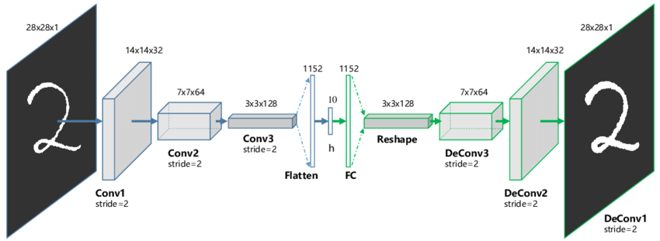
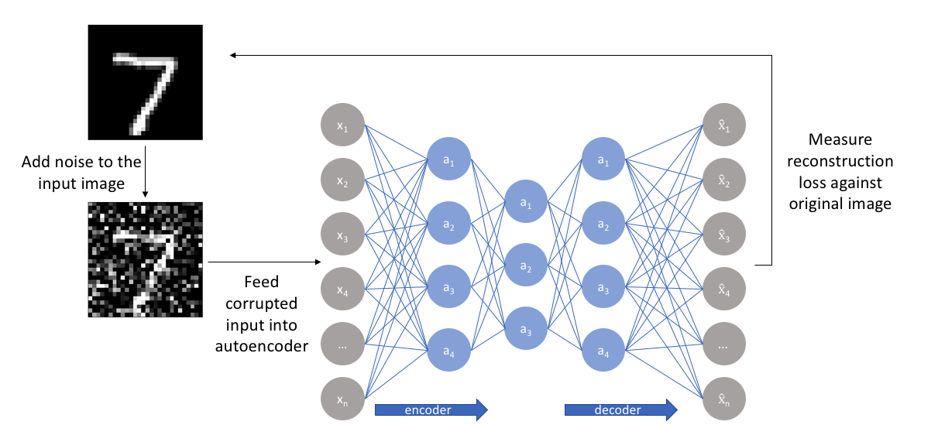
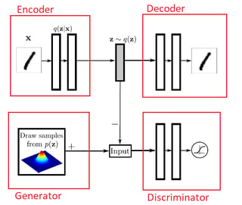
Types of Autoencoders (Continued)
Convolutional Autoencoder (CAE)
Uses convolutional layers instead of fully connected layers
Preserves spatial information
Contractive Autoencoder
Adds a contractive penalty to the loss function to prevent small changes in input from drastically affecting the latent space representation
Makes the model more robust against noise
Adversarial Autoencoder (AAE)
Combines an autoencoder with an adversarial network
The encoder learns to map inputs to a latent space distribution that matches a target distribution

Slide 6
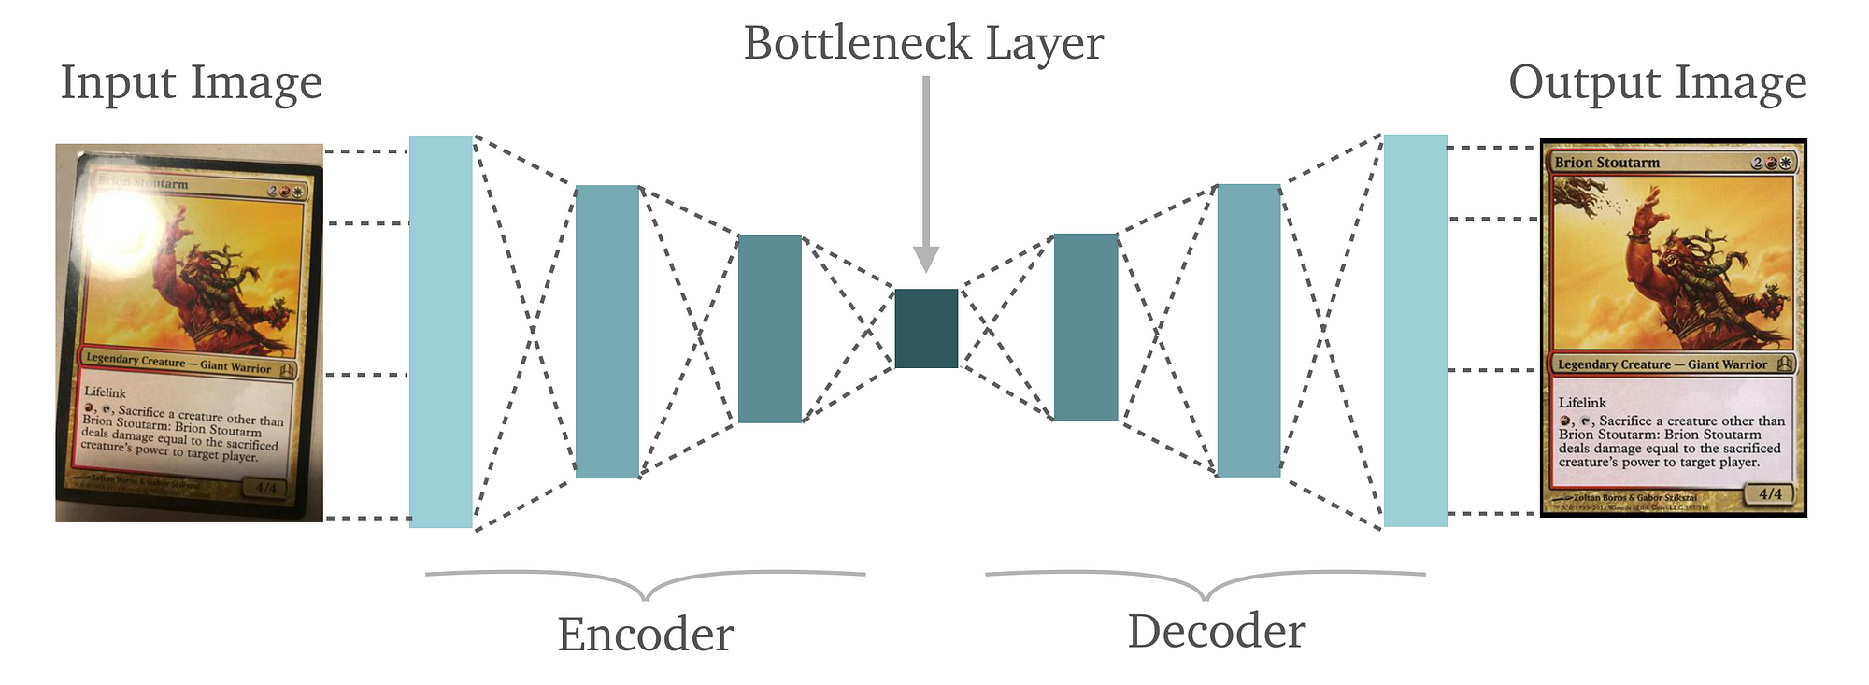
Use Cases
Autoencoders can be used in a variety of ways, such as:
Feature detection:
Vanilla
Sparse
Contractive
Image compressing:
Vanilla
Convolutional
Denoising
Denoising
Convolutional
Domain Adaptation
Adversarial
Synthetic data generation
VAE
Adversarial
Anomaly detection
Sparse
Ex: Denoised image produced by Convolutional Autoencoder

Slide 7
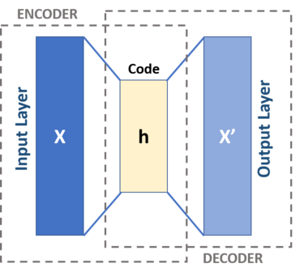
Problems with simple autoencoders
The simple autoencoders create a fixed reconstructed version of the input data
There are pixel limitations with the reconstructed version as well as non-averaged inputs of the data input, it is a direct input to output
There is no variability in ability to create probability distribution of the encoded data (VAE Encoders do this)

Slide 8
What is a VAE autoencoder?
The VAE autoencoder uses a dynamic average of the encoded data of a probability distribution into the sample latent space - the mean and variance of the encoded data
When decoding, it pulls from the sample latent space compared to a regular encoder
When reconstructing the image, it is synthetically reproduced from the latent space to the decoded output.
There is a reparmatized method with “e” epsilon that has a mean of zero and a stand deviation of 1 for a reference point when doing back propagation
Notes:
Image Notes: The scheme of the reparameterization trick. The randomness variable
ε
is injected into the latent space
z
as external input. In this way, it is possible to backpropagate the gradient without involving stochastic variable during the update.
VAEs introduce a sampling step in the latent space, where instead of encoding inputs as fixed points, they encode them as probability distributions (mean μ and variance σ²). This creates a challenge for backpropagation because we cannot directly differentiate through a sampling operation.

Slide 9
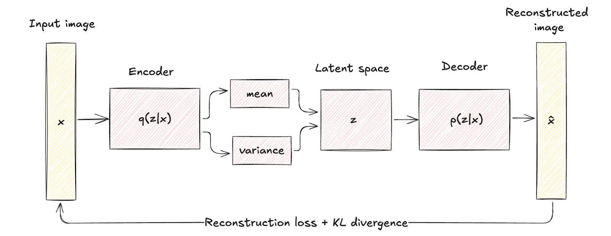
Architecture of a VAE Autoencoder

Slide 10
What we will be doing today
Today we will be downloading the Fashion MNIST dataset and generating new synthetic images based on the images inside of this data set.
Things to know:
This set contains 28x28 images of different clothing items
Images in this data set are grayscale
Training set contains 60,000 images and testing contains 10,000 images
Images produced by our autoencoder won’t be identical to images in the set, they will be similar but not the same (imperfect copies based on important features)
Overall Goal for the Lab: Try to create new useable synthetic data for testing
Dataset: https://www.kaggle.com/datasets/zalando-research/fashionmnist

Slide 11
Try it yourself!
Go To the VAE Autoencoder Workshop folder on GitHub

Slide 12
Conclusions
Certainly worth using if you need to reconstruct data
Great for anomaly detection
VAE autoencoders offer a more robust autoencoder

